Slide 1
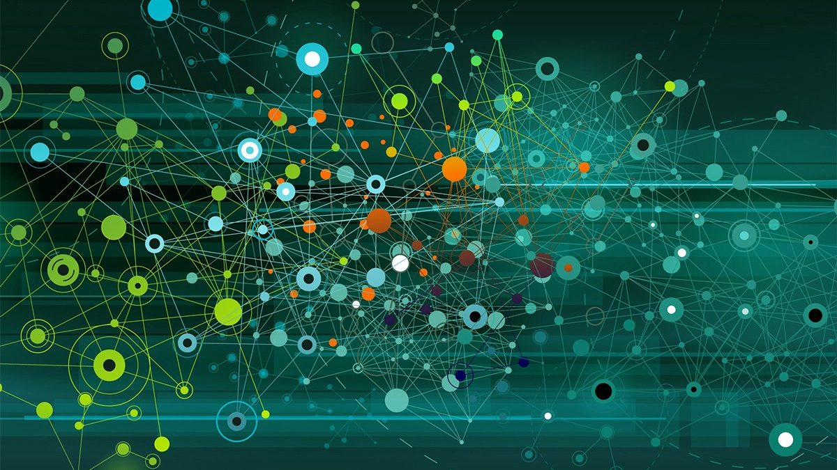
Computational Power of Learning Process
Manasa Noolu
AI Intern-BeCode

Slide 2
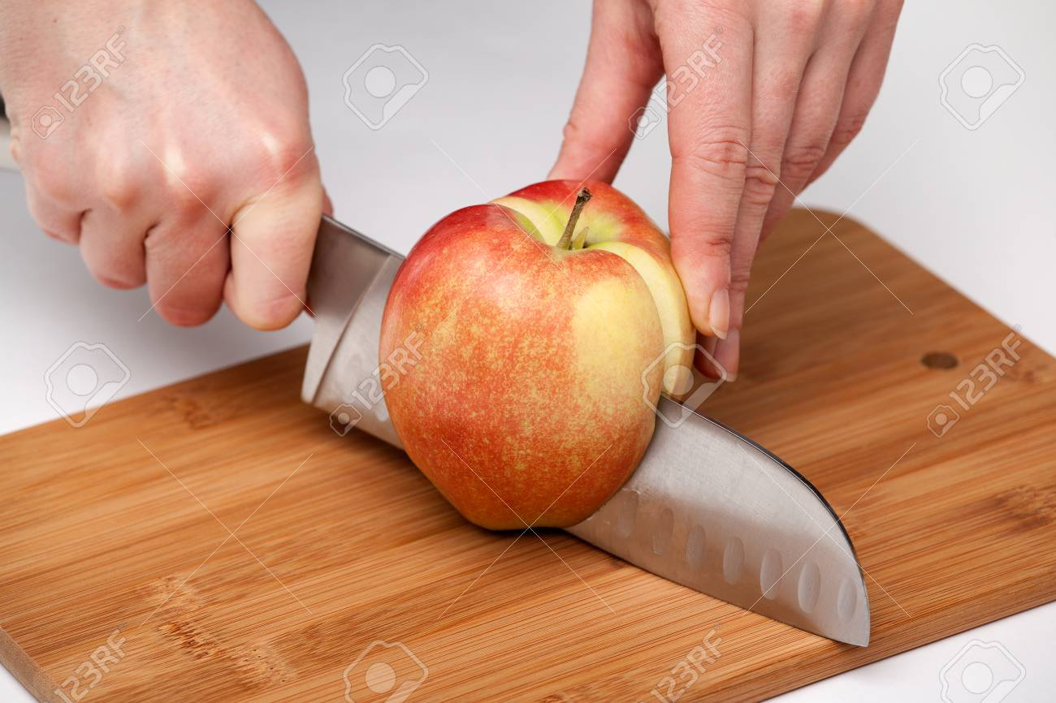
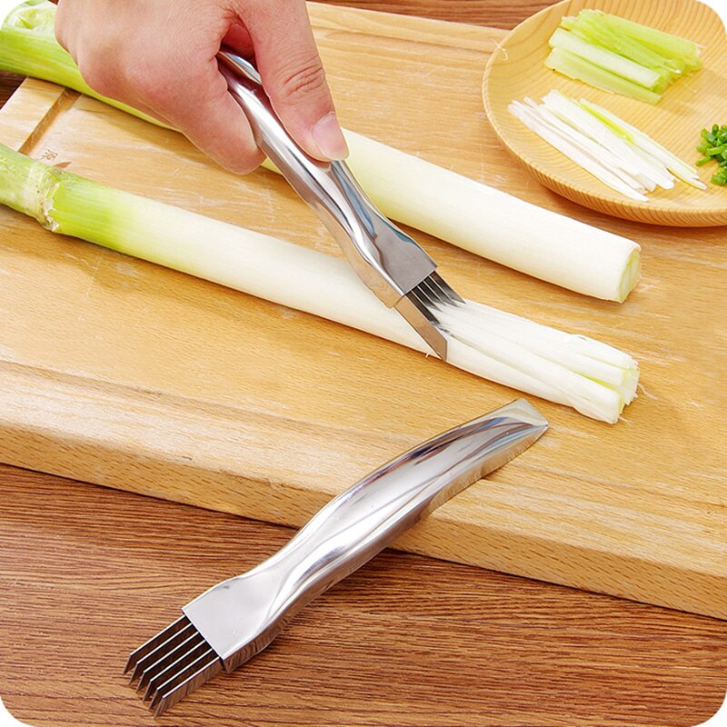
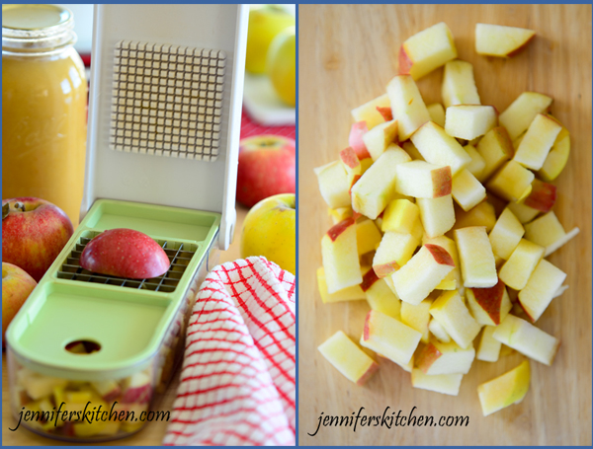
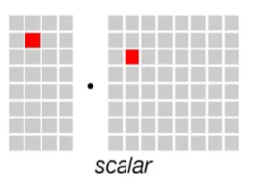
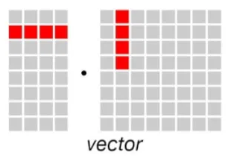
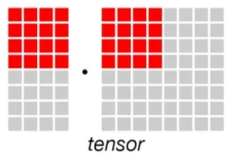
Learning Process in AI

Slide 3
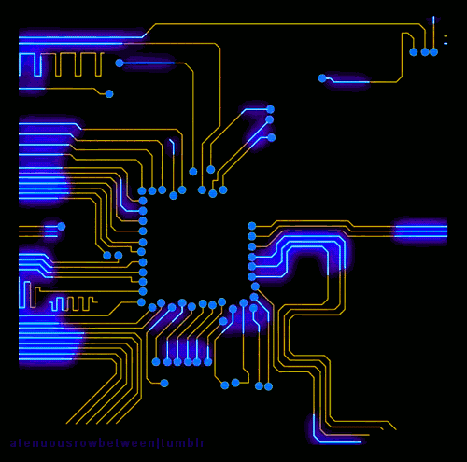
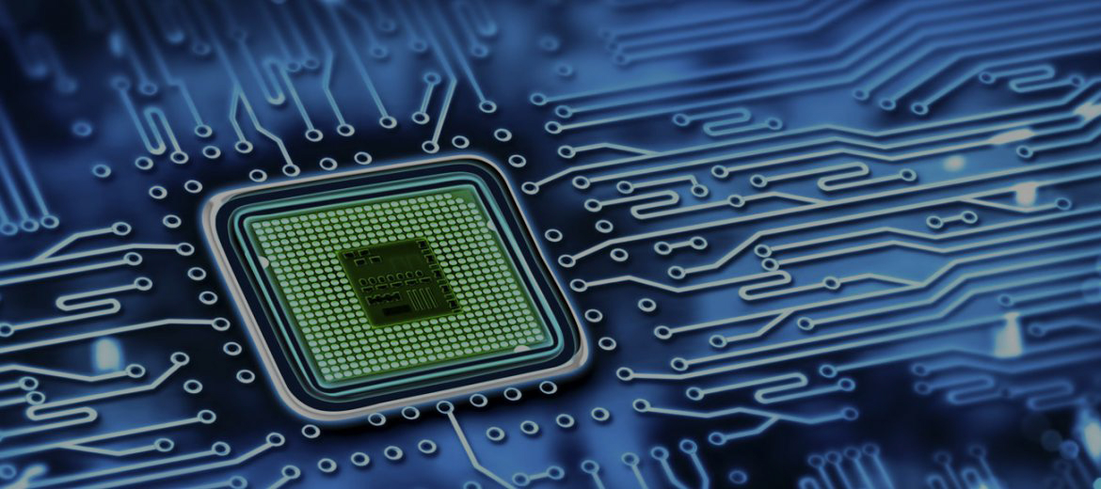
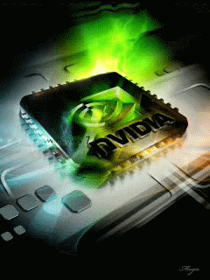
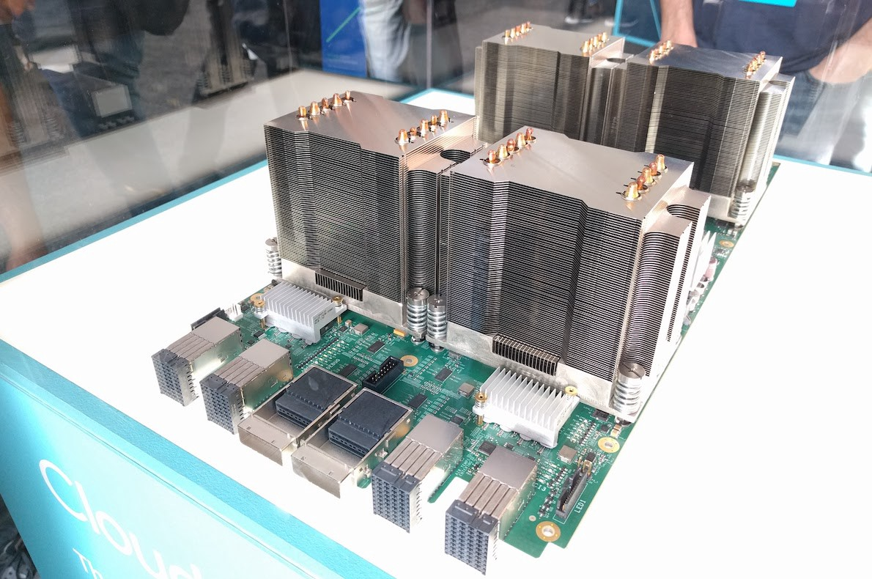
Evolution of Computing Power
Central Processing Unit
Field-Programmable Gate Array
Intel
Microsoft
1980-
2014-
Graphical Processing Unit
Tensor Processing Unit
NVIDIA
Google
2010-
2016-

Slide 4
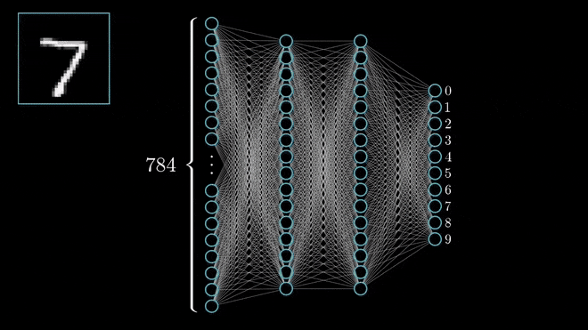

Slide 5
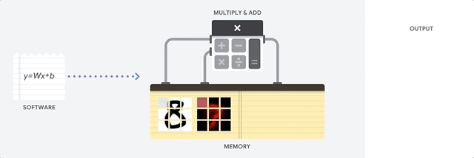
CPU

Slide 6
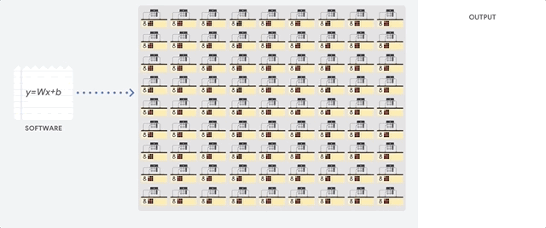
GPU

Slide 7
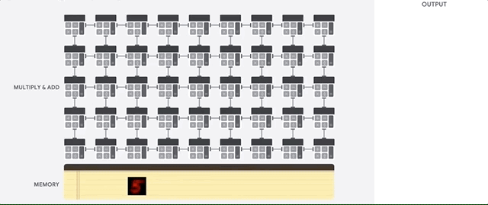
TPU

Slide 8

Google Colab
Hosted Jupyter notebook environment
Free cloud service
Keras, TensorFlow, PyTorch, and OpenCV
Commit to GitHub

Slide 9
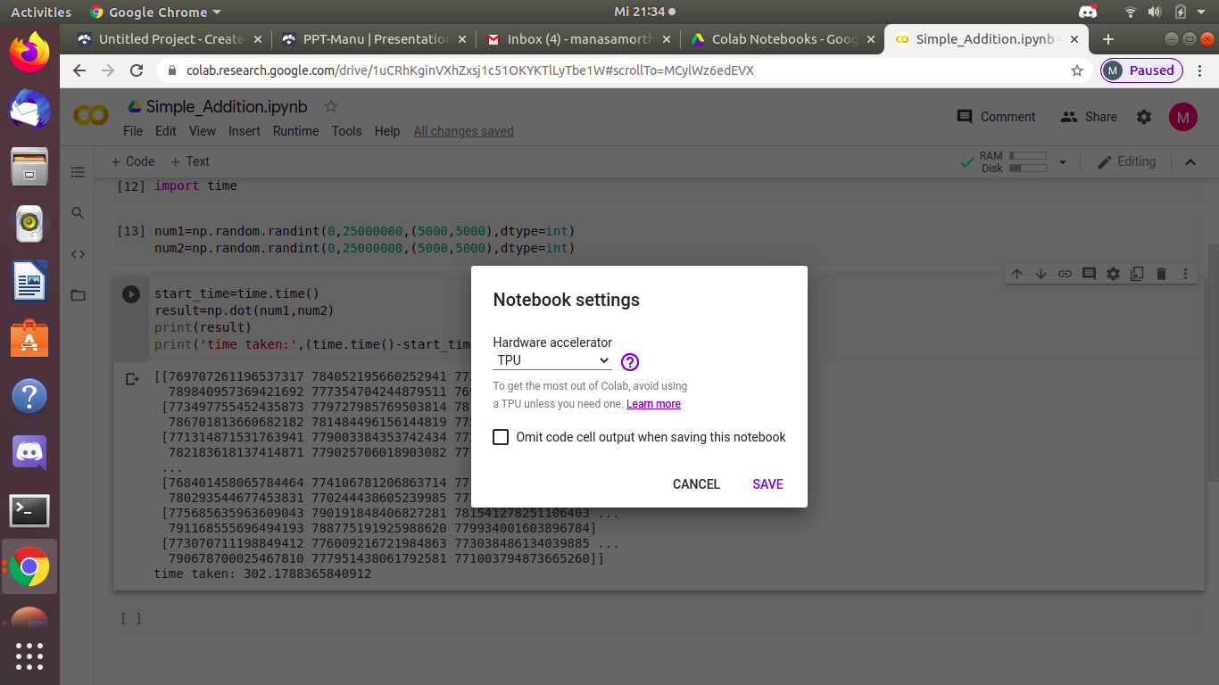

Slide 10


Slide 11
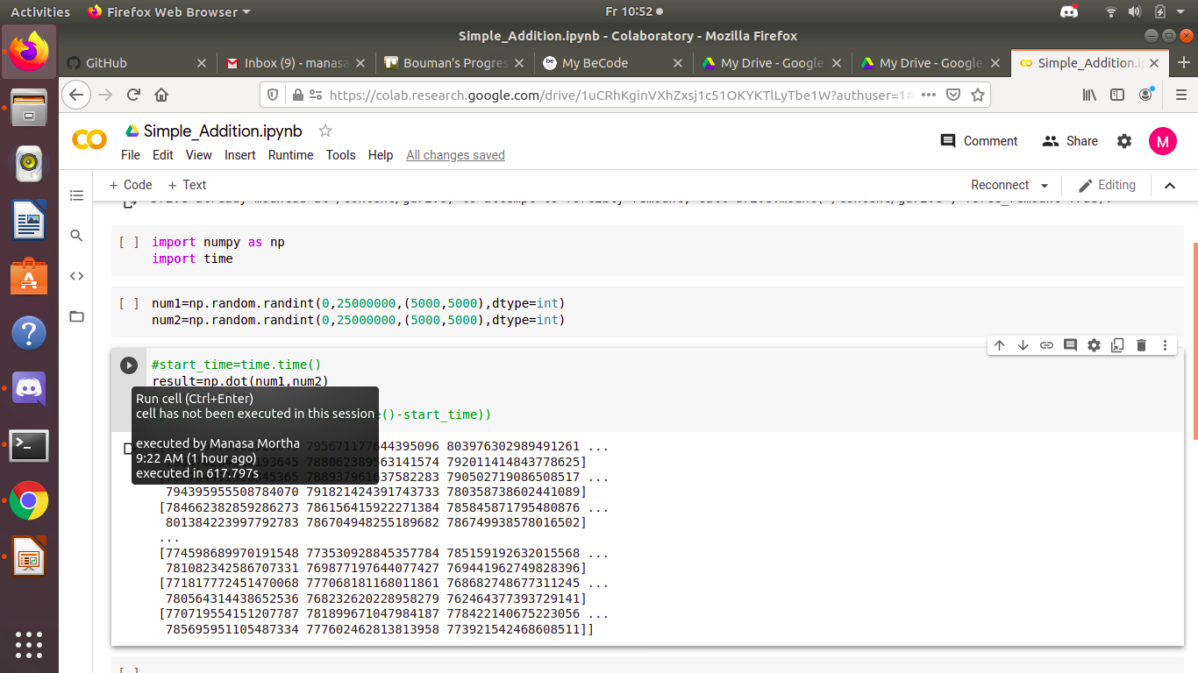

Slide 12
Queries?????

Slide 13
Thank you

